Slide 1


Applied Cryptography
Ms. Swati Mali
B-215
swatimali@gmail.com
Assistant Professor, Department of Computer Engineering
K. J. Somaiya College of Engineering
Somaiya Vidyavihar University

Slide 2
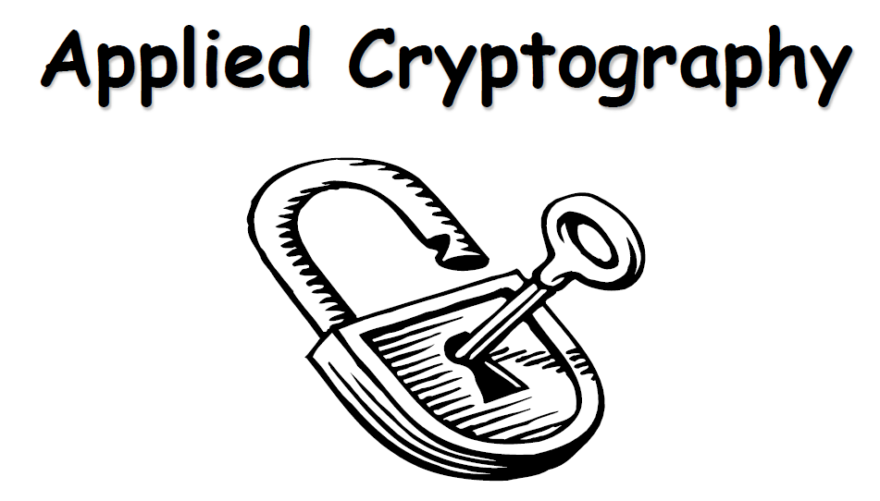

Slide 3
What is this course about?
Objectives
  Security needs / threats
  Security Goals
  Cryptography

Slide 4
What we will cover?
–Vulnerabilities, threats, security Goals, and methods of defense
–Cryptography
–Symmetric
–Asymmetric
–Message authentication and digital signature
–Advances in Cryptography

Slide 5
Vulnerability, Threat and Control
A vulnerability is a weakness in the security system, in procedure, design, or implementation that might be exploited to cause loss or harm
A threat to a computer system is a set of circumstances that has the potential to cause loss or harm
Control is an action, device, procedure, or technique that removes or reduces a vulnerability
A threat is blocked by control of a vulnerability

Slide 6
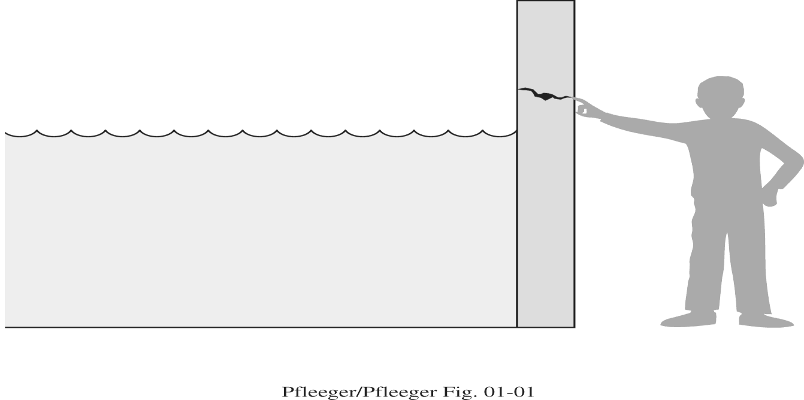
Threats, Controls, and Vulnerabilities

Slide 7
Threats, Controls, and Vulnerabilities
Glass home
Social media
Land slide
Bank transaction
Covid vaccine booking
Online zoom calls

Slide 8
Attacks, Services and Mechanisms
Security Attack: Any action that compromises the security of information.
Security Mechanism: A mechanism that is designed to detect, prevent, or recover from a security attack.
Security Service: A service that enhances the security of data processing systems and information transfers. A security service makes use of one or more security mechanisms.

Slide 9
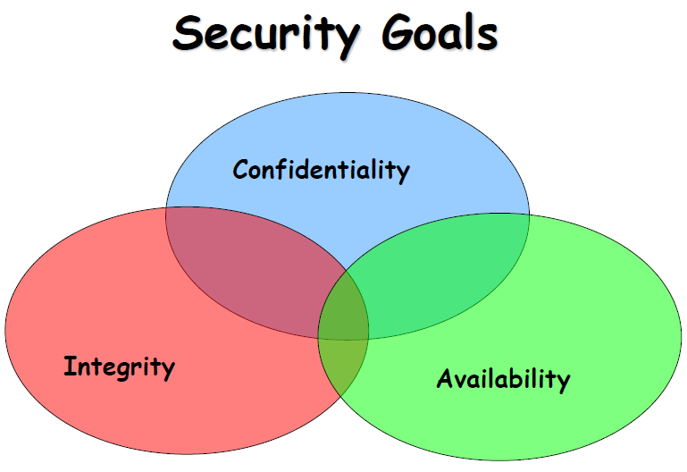
Books

Slide 10
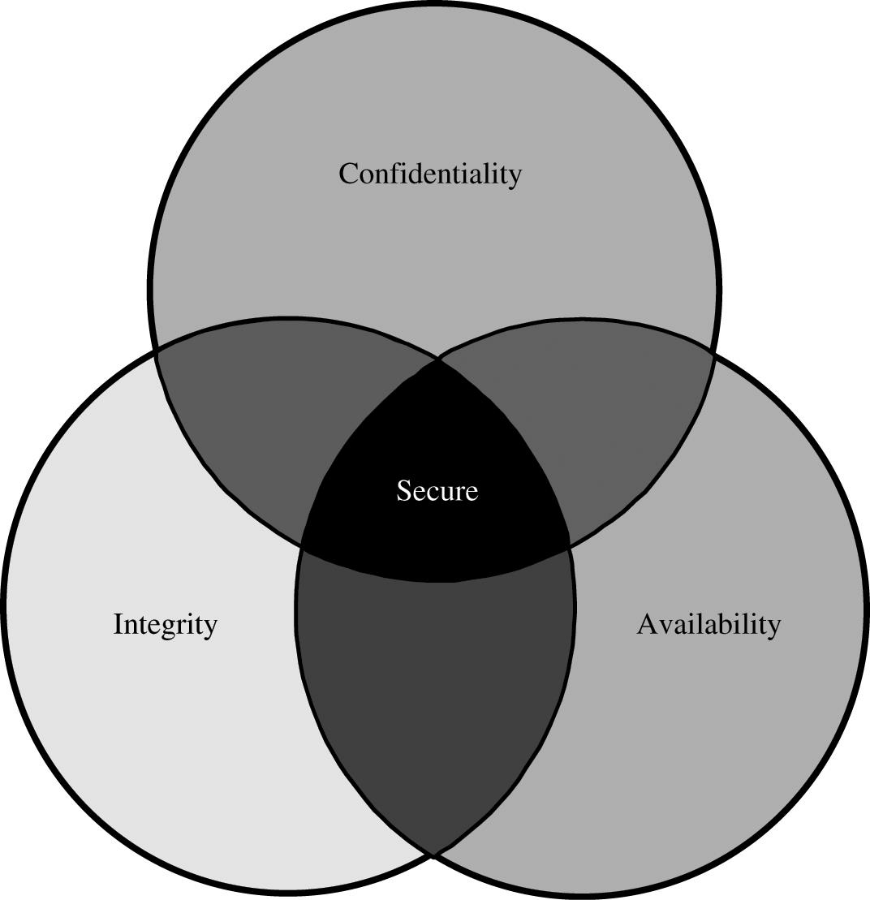
Relationship Between Confidentiality, Integrity, and Availability

Slide 11
Confidentiality
It ensures that computer-related assets are accessed only by authorized parties
Access means reading, viewing, printing, or simply knowing that a particular asset exists
It is sometimes also called secrecy or privacy

Slide 12
Integrity
It means that assets can be modified only by authorized parties only in authorized ways.
The integrity of an item is preserved if it is:
  Precise, accurate, unmodified, modified only in acceptable ways, modified by authorized people, modified by authorized processes, consistent, meaningful and usable.

Slide 13
Availability
It applies to both data and data processing
A data item, service or system is available if
  There is a timely response to our request
  Fair to all i.e. some requesters are not favored over others
  Fault tolerant
  There is controlled concurrency, deadlock management, and exclusive access as required

Slide 14
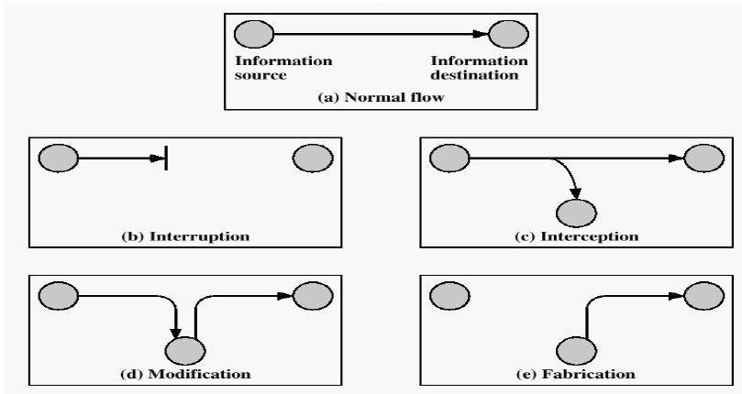
Security Attacks

Slide 15
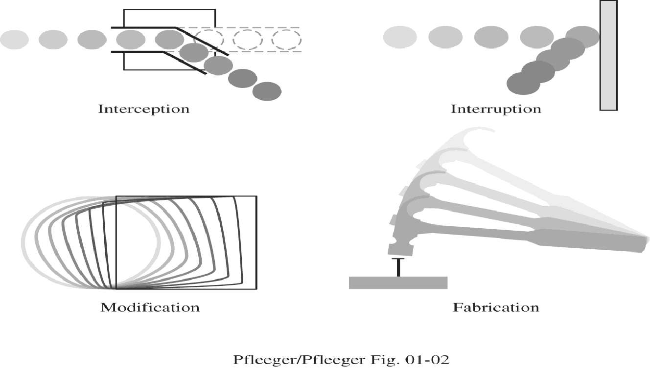

Slide 16
Security Attacks
Interruption: This is an attack on availability, confidentiality
Interception: This is an attack on confidentiality
Modification: This is an attack on integrity
Fabrication: This is an attack on authenticity

Slide 17
Classical attacks on security
Eavesdropping
Traffic Analysis attack
Replay attack
non-repudiation attack
Man-in-the-Middle attack
Data Tampering
Denial of Service (DoS) attack
Brute Force Attack
zero day exploit attack,
Phishing and social engineering
Spoofing
Malware
Session hijacking attack

Slide 18
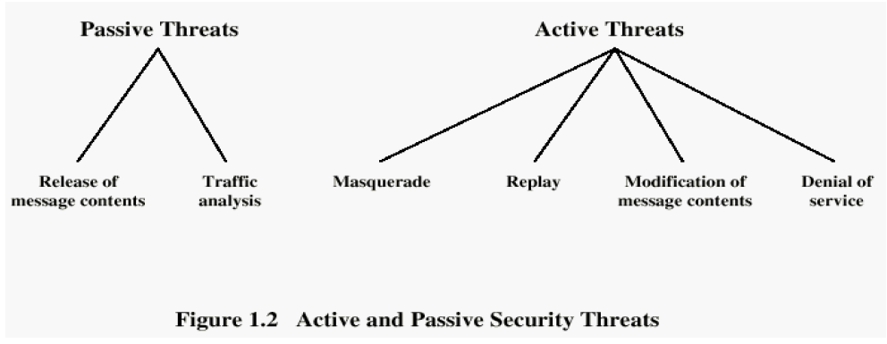

Slide 19
Attacks
Cryptanalytic Attacks
  Exploit mathematical weakness of cryptographic algorithm
Non-cryptanalytic Attacks
  Threats to goal of security

Slide 20
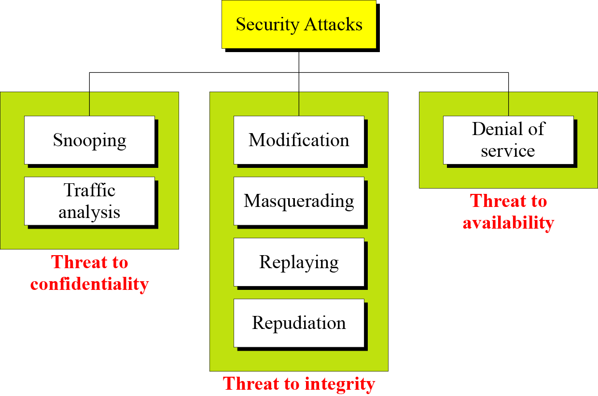

Slide 21
Security Services
Confidentiality (privacy)
Authentication (who created or sent the data)
Integrity (has not been altered)
Non-repudiation (the order is final)
Access control (prevent misuse of resources)
Availability (permanence, non-erasure)
  Denial of Service Attacks
  Virus that deletes files

Slide 22
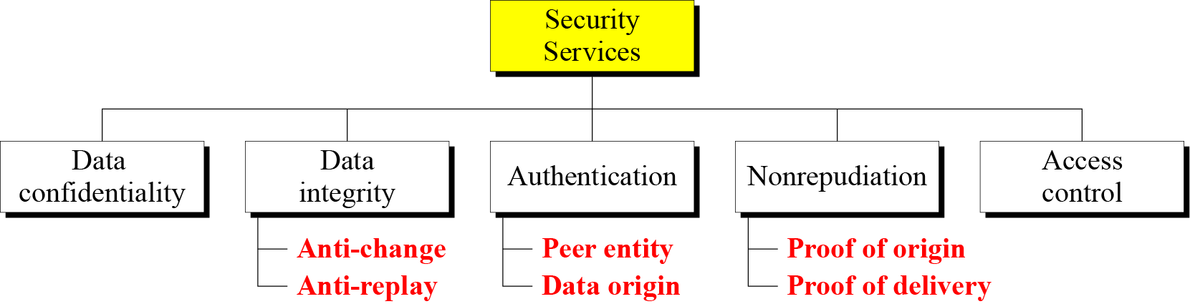

Slide 23
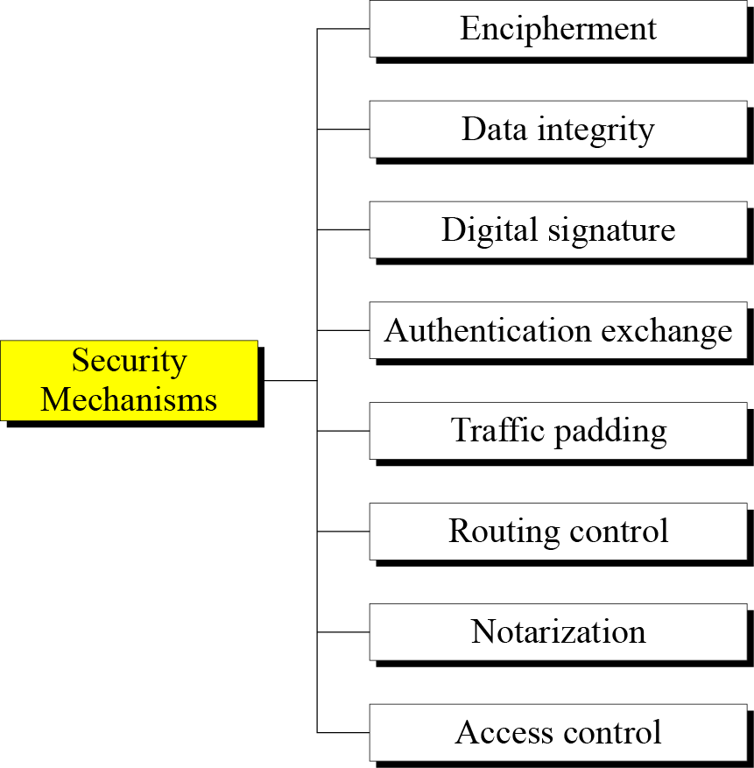

Slide 24
Vulnerabilities
Hardware vulnerabilities
Software vulnerabilities
  Software deletion
  Software modification
    Viruses etc.
  Software theft
Unauthorized copying etc.
Data vulnerabilities

Slide 25
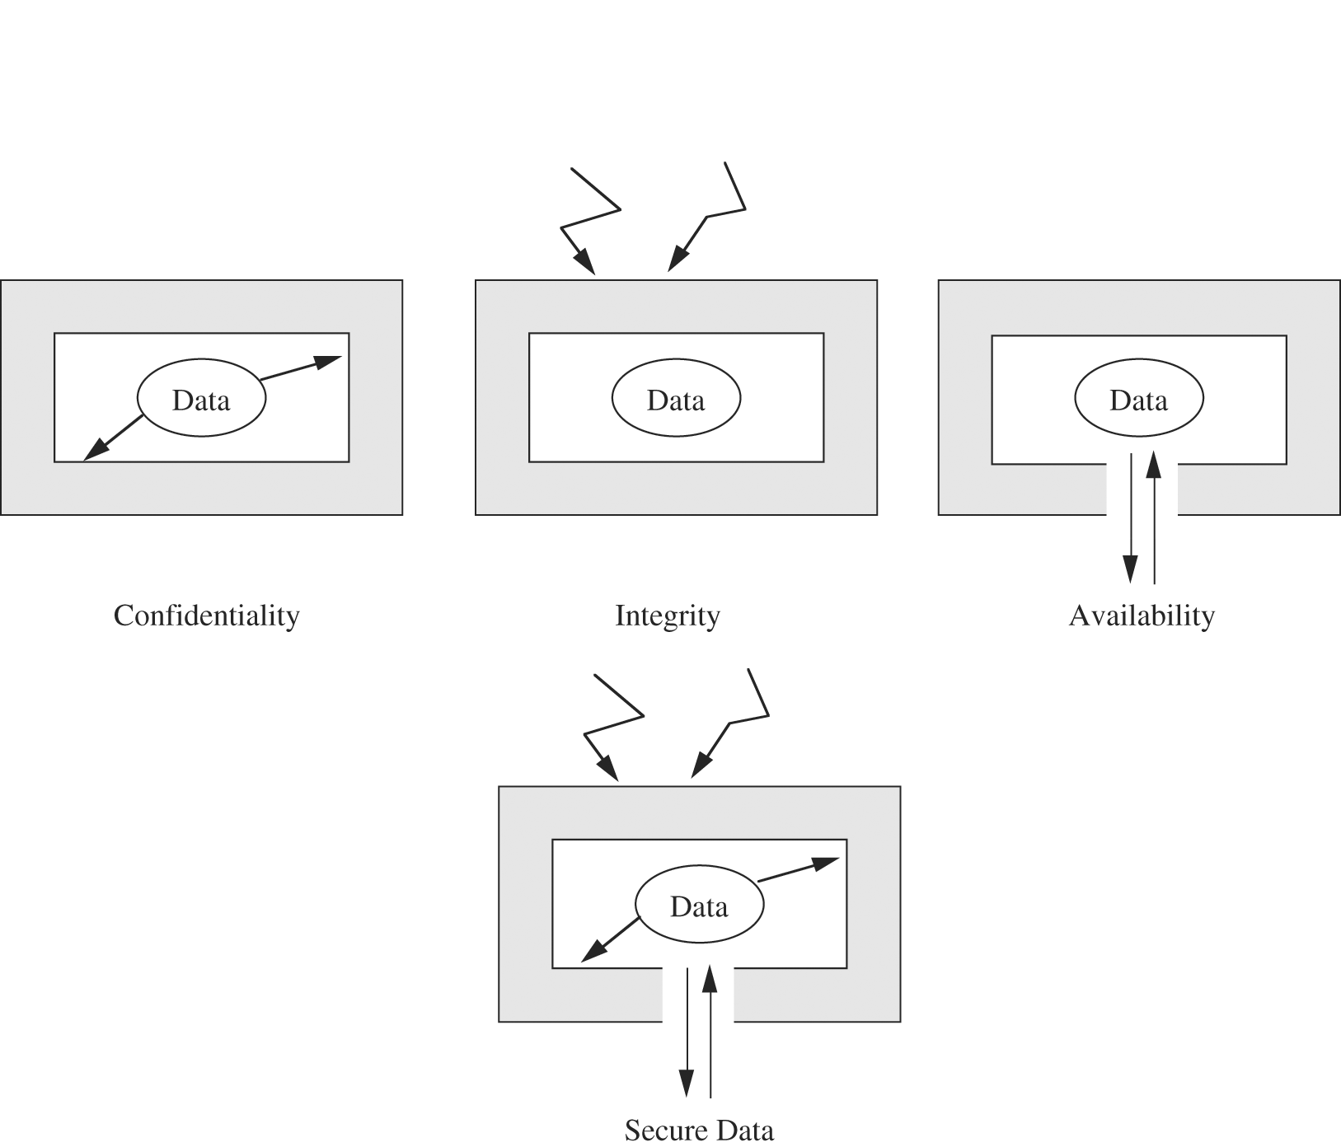
Data Security

Slide 26
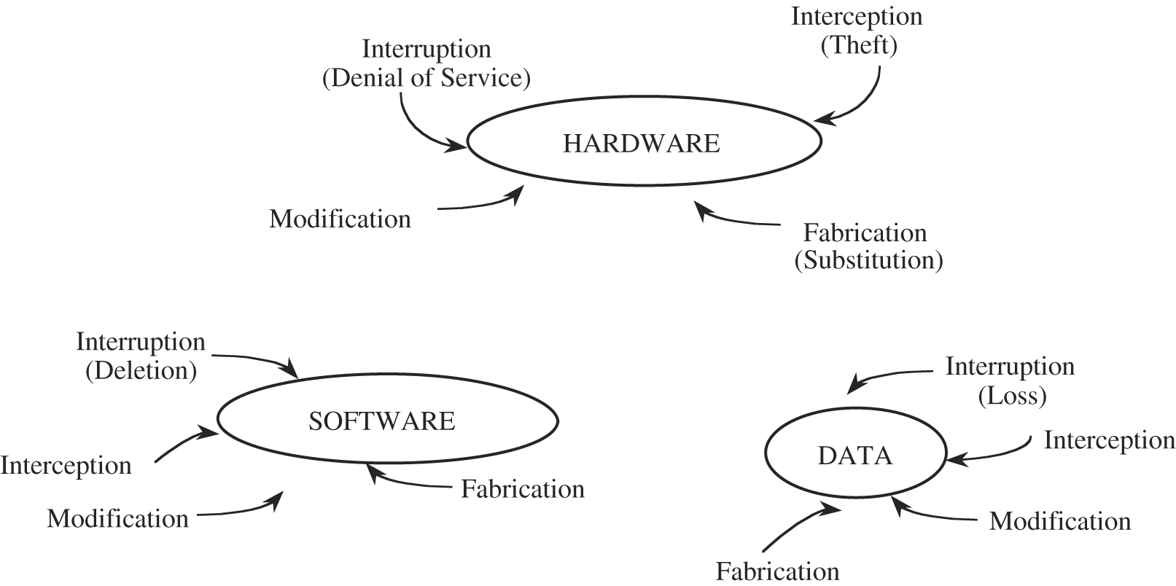
Computing system vulnerabilities

Slide 27
Methods of Defense
Prevent it, by blocking the attack or closing the vulnerability
Deter it, by making attack harder if not impossible
Deflect it, by making another target more attractive
Mitigate it, by making its impact less severe
Detect it, either as it happens or some time after the fact
Recover from its effects

Slide 28
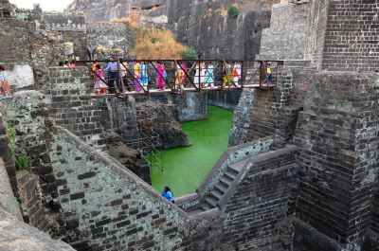
Multiple levels of Defence

Slide 29
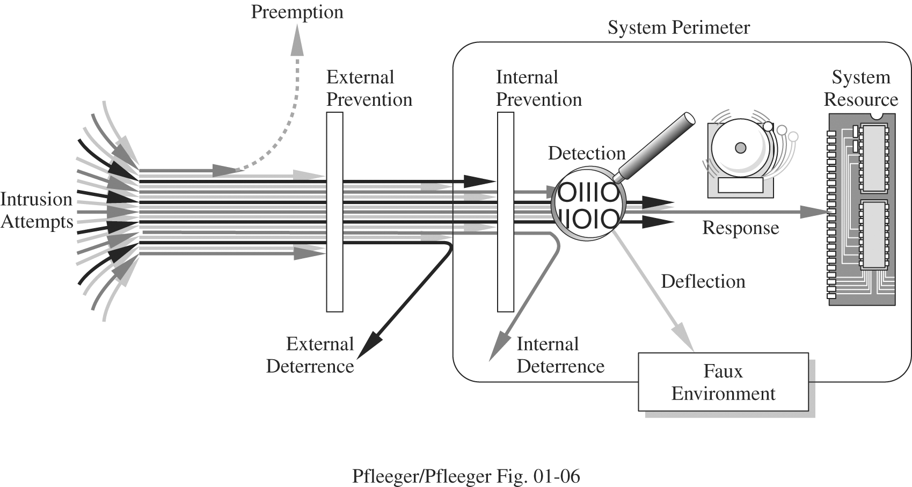
Multiple levels of Defence

Slide 30
Methods of Defense
Controls
  Encryption
  Hardware Controls
    Hardware/smart card implementations of encryption
    Locks or cables limiting access
    Devices to verify users’ identity
    Firewalls
    Intrusion detection systems
  Software Controls
    Internal program controls,
    OS and Network system controls
    Independent control program (anti virus, passwords etc.)
    Development control
  Policies and Procedures
    Time restrictions
    Geofencing
    Standard development Environment
    Non Disclosure Agreement
  Physical Controls
    locks
    biometrics
    guards

Slide 31
Reading slides:Computer Criminals
Amateurs
  Personal works
Crackers
  Trying to access computing facilities for which they are not authorized
  The perception that nobody is hurt or even endangered by a little stolen machine time
  Others attack for curiosity, personal gain, or self-satisfaction
Career Criminals

Slide 32
Reading slides:Method, Opportunity and Motive
Method : the skills, knowledge, tools and other things with which to be able to pull off the attack
Opportunity : the time and access to accomplish the attack
Motive : a reason to want to perform this attack against this system
DENY ANY OF THESE THREE THINGS AND
ATTACKS WILL NOT OCCUR

Slide 33
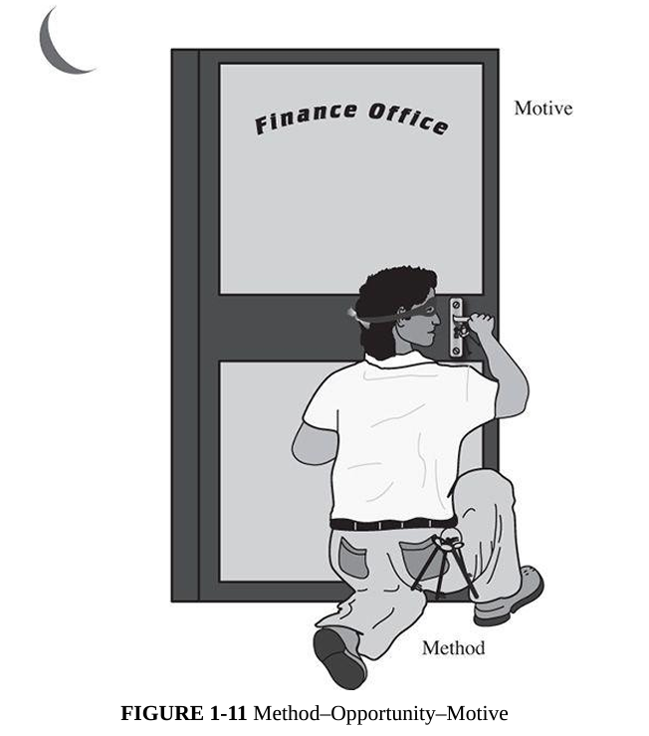
Reading slides:MOM

Slide 34
Reading slides:MOM : EVM – breaking
Method | - Skills and Knowledge: Understanding of EVM hardware and software, including operating systems, communication protocols, and cryptographic systems.
 | - Tools: Specialized hardware (e.g., card readers, microcontrollers, or probes), software tools to analyze or reverse-engineer firmware, and pre-designed attack scripts available online.
 | - Resources: Access to programming manuals, technical specifications, and publicly available security research papers on EVMs.
 | - Attack Variants: Techniques like malware injection, side-channel attacks, or exploiting software/firmware vulnerabilities to alter results or compromise integrity.
Opportunity | - Access Points: Physical access during storage, transport, or voting; insider threats from technicians or election staff.
 | - System Weaknesses: Poorly implemented security protocols, use of default settings, lack of tamper-evident features, or absence of robust monitoring mechanisms during elections.
 | - Operational Gaps: Temporary loss of custody during transit, inadequate auditing of results, or lack of rigorous testing for vulnerabilities.
 | - Public Accessibility: In some cases, older or widely used EVM models are studied extensively, making their weaknesses well-known.
Motive | - Political: Altering election outcomes to favor specific candidates or parties.
 | - Financial: Bribes or monetary gains in exchange for compromising election integrity.
 | - Ideological: Disrupting democratic processes to undermine trust in governance or to promote political agendas.
 | - Reputation: Demonstrating technical prowess by hacking high-profile systems like EVMs.
 | - Sabotage: Creating confusion, delaying results, or delegitimizing election outcomes by spreading misinformation about the security of EVMs.

Slide 35
Reading slides:MOM : EVM – breaking
Actor | Method | Opportunity | Motive
Amateur Hackers | - Using publicly available hacking tools. | - Insecure endpoints (voting kiosks, admin panels). | - Gaining recognition or thrill.
 | - Exploiting weak or reused passwords. | - Lack of encryption in communication. | - Testing their hacking skills for personal satisfaction.
 | - Basic phishing or social engineering techniques. | - Minimal technical safeguards in place.
Anti-Social Individuals | - Spreading misinformation via fake e-voting portals. | - Overloaded servers. | - Causing disruption and chaos.
 | - DDoS attacks to disrupt voting processes. | - Lack of traffic filtering mechanisms. | - Undermining public trust in technology and elections.
 | - Tampering with voters’ devices. | - High dependence on online systems without backup mechanisms.

Slide 36
Reading slides:MOM : EVM – breaking
Actor | Method | Opportunity | Motive
Anti-Democratic Groups | - Altering vote tallies by breaching databases. | - Poorly secured servers and databases. | - Undermining democracy to destabilize the nation.
 | - Installing backdoors in e-voting infrastructure. | - Insider access to the election systems. | - Promoting authoritarian control.
 | - Manipulating algorithms in vote counting software. | - Lack of robust access control mechanisms.
Notorious-Studious Hackers | - Creating custom malware to infiltrate systems. | - Lack of regular security audits. | - Gaining fame or infamy.
 | - Exploiting zero-day vulnerabilities. | - Use of outdated software/hardware. | - Demonstrating technical superiority.
 | - Reverse-engineering voting software to identify flaws. | - Absence of real-time anomaly detection in e-voting systems. | - Selling vulnerabilities to third parties.
Politicians | - Colluding with insiders to manipulate vote records. | - Access to campaign funds and influence over infrastructure. | - Gaining an unfair advantage to win elections.
 | - Funding professional hackers to breach systems. | - Exploiting politically aligned insiders. | - Ensuring their political power remains intact.
 | - Using legal loopholes to influence voting systems. | - Weak regulatory oversight of election systems.

Slide 37
Reading slides:MOM : EVM – breaking
Actor | Method | Opportunity | Motive
Foreign Governments | - Advanced persistent threats (APTs) targeting critical election systems. | - Cross-border jurisdiction limits enforcement. | - Undermining the country’s political stability.
 | - Spreading propaganda and misinformation campaigns. | - Geopolitical tensions creating vulnerabilities. | - Influencing policies to favor their own geopolitical interests.
 |  | - Lack of robust international cybersecurity coordination.
Criminal Organizations | - Stealing voter data for identity theft. | - Weak encryption on databases. | - Financial gain through data sales.
 | - Selling vote manipulation as a service (election fraud as a business). | - Lack of robust authentication for accessing systems. | - Running election fraud services for profit.
 |  | - High black-market demand for personal and voter information.
Disgruntled Employees/Insiders | - Leaking sensitive data about voters or systems. | - Direct access to e-voting infrastructure. | - Personal vendetta against employers or the government.
 | - Tampering with configurations to enable external breaches. | - Minimal monitoring of employee activity. | - Financial gain from selling information or services.
 | - Intentionally bypassing security measures. | - Insufficient background checks or employee screening.

Slide 38
Reading slides:
Actor | Method | Opportunity | Motive
Activist Groups (Hacktivists) | - Defacing e-voting portals to spread their message. | - Overreliance on online platforms without redundancy. | - Advocating for their causes.
 | - Blocking systems through DDoS. | - Lack of regular penetration testing. | - Exposing perceived flaws in the democratic system.
 | - Manipulating results to make a statement. | - Misconfigured public-facing services. | - Drawing attention to their ideologies.
Curious Researchers | - Ethical hacking to identify flaws. | - Access to test environments or real systems due to weak authorization checks. | - Publishing findings to improve security.
 | - Testing various attack methods (often with consent). | - Collaboration with system administrators without strict boundaries. | - Building a reputation in cybersecurity circles.

Slide 39
Reading slides: Effectiveness of Controls
Awareness of Problem
  Highlighting Need of security
Likelihood of Use
  They must be efficient, easy to use, and appropriate
Overlapping Controls
  Use several different controls, layered defense
Periodic reviews
  Judging the effectiveness of control is an ongoing task

Slide 40
Others Exposed Assets
Networks
  Network’s lack of physical proximity
  Use of insecure, shared media
  Inability to identify remote users positively
Access
  Computer time
  Malicious access
  Denial of service to legitimate user
Key People

Slide 41
An attacker secretly intercepts communication between two parties to steal credentials.

Slide 42
A user receives a fake email asking to update bank details, which leads to credential theft.

Slide 43
A hacker floods a website with traffic until it becomes unavailable to real users.

Slide 44
An attacker captures and reuses valid authentication messages to gain unauthorized access.

Slide 45
An attacker installs spyware to collect sensitive user information without consent.

Slide 46
A hacker modifies data in transit to alter financial transactions.

Slide 47
An attacker sends thousands of password attempts to crack a user's account.

Slide 48
A cybercriminal exploits an unknown vulnerability before the vendor can patch it.

Slide 49
An attacker impersonates a trusted website to steal login credentials.

Slide 50
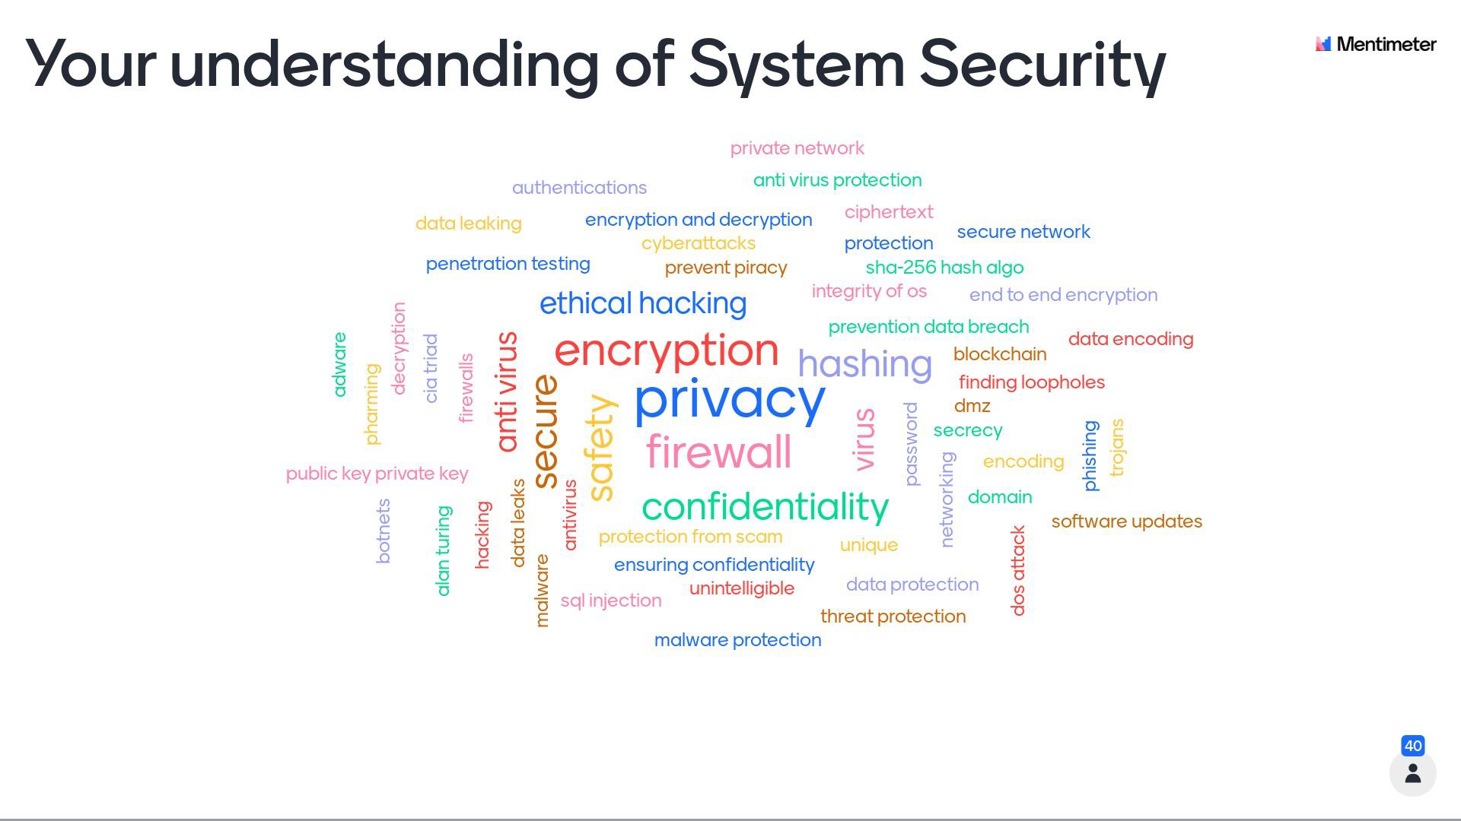

Slide 51
Questions?

